Slide 1


IDS 1721
Computing and Problem Solving for STEM Chapter 01
Introduction

Slide 2
Introduction, Course Syllabus, and Coding Software
Welcome to IDS 1721!
This foundational course provides relevant computational methods and required fundamentals in scientific computing to problem solving in engineering, computer science, and related STEM disciplines.
The course is designed with the thinking process for solving problems as the critical step before coding.
Students will practice problem solving techniques, develop pseudocode, apply the computing model with hand calculations to finally implement software that will provide the foundation for future success in a STEM curriculum.
Students will produce working code that uses decisions and iterations as an important part of this course.

Slide 3
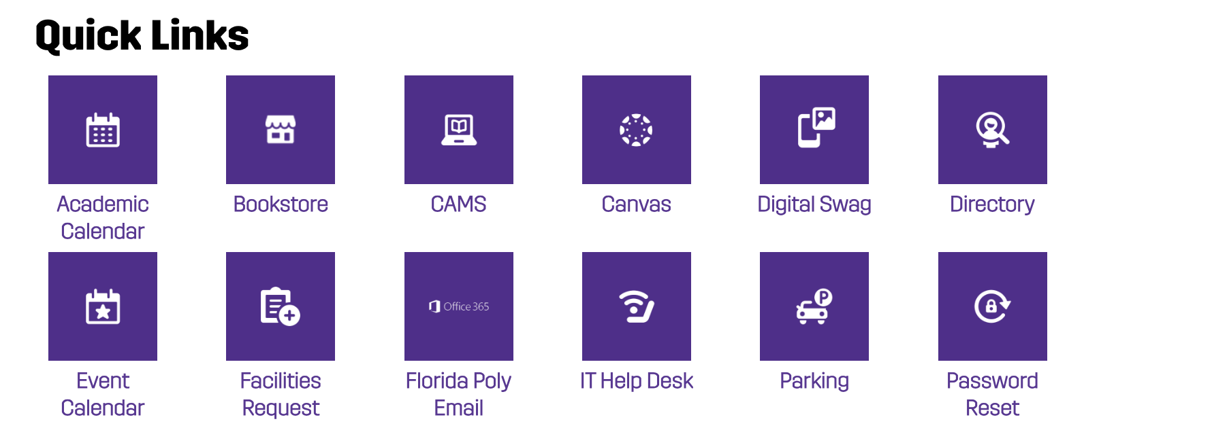
Introduction, Course Syllabus, and Coding Software
Everything is on Canvas!
https://floridapoly.edu/i-am-a/current-student.php
Few important things I want to go through…

Slide 4
Introduction, Course Syllabus, and Coding Software
Course Details:
Class Meeting Day, Time & Location: TR 2:00 – 3:15 PM at IST-1026
Instructor: Somak Das
Office Location: IST 2014
Office Hours: MWF 1:00-1:50 PM, TR 1:00-1:30 PM
Email address: sdas@floridapoly.edu

Slide 5

Introduction, Course Syllabus, and Coding Software
Lecture Slides:
Lectures slides will be available to download after class in PDF format
Problems (including code) will be in class, so yes, please take notes!
Any other supplemental materials to include (but not limited to) such as handouts, video links, etc. will also be available on Canvas.
Note: You are not permitted to post these lectures on any websites, forums, Discord channels, etc.
Notes:
Please emphasize the lectures are NOT to be posted by the students to any world-wide websites, online forums, or discussion boards.

Slide 6
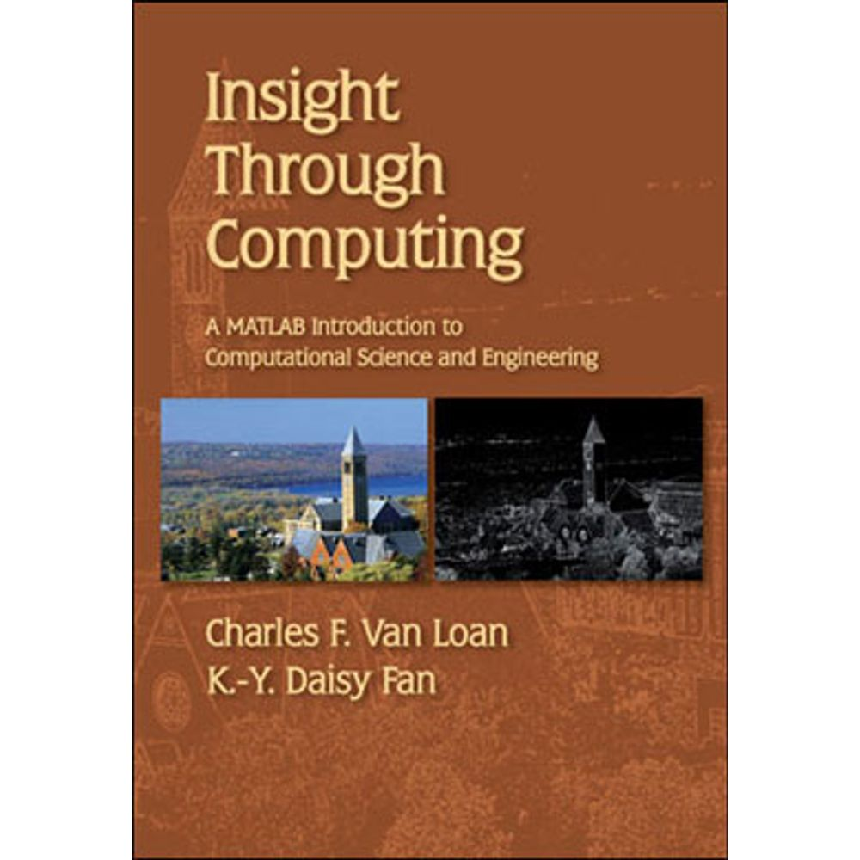
Introduction, Course Syllabus, and Coding Software
Required Texts and Materials: Insight through Computing: A MATLAB Introduction to Computational Science and Engineering, Charles F. Van Loan & K.-Y. Daisy Fan, SIAM, 2010, ISBN:978-0-89871-691-7
Equipment and Materials: Canvas, tablet, PC, laptop, Rocketbook or similar, web browser, Microsoft Office, FL Poly email, calculators [Approved: TI-30XIIS (approx. $10) or TI-30XS Multiview (approx. $16)]

Slide 7
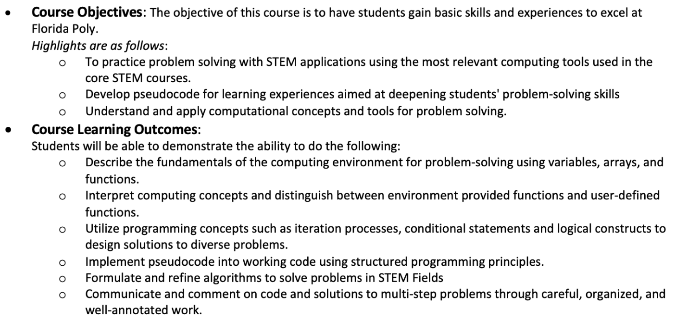
Introduction, Course Syllabus, and Coding Software

Slide 8
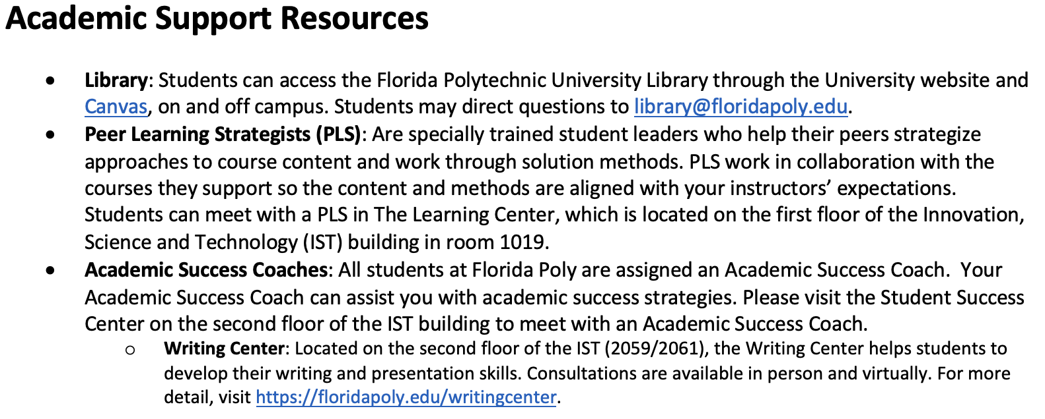

Introduction, Course Syllabus, and Coding Software

Slide 9
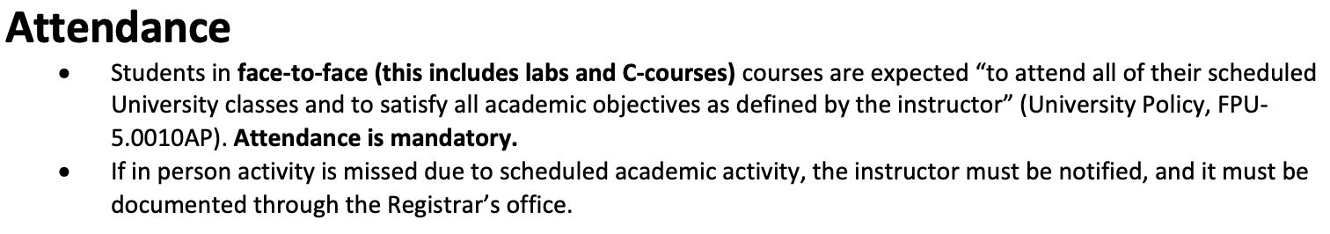

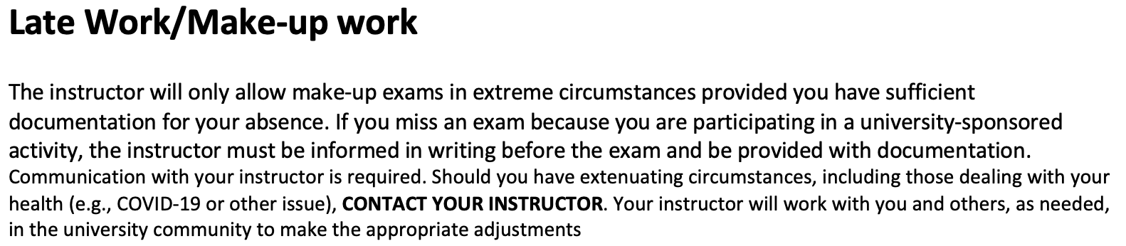
Introduction, Course Syllabus, and Coding Software

Slide 10
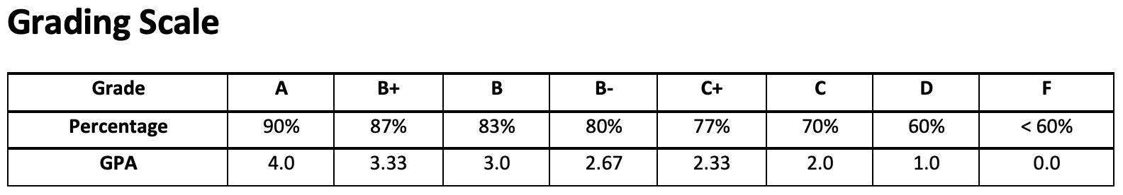
Introduction, Course Syllabus, and Coding Software
Notes:
Please state the grading scale is set and will not change. The grades will NOT be curved, and you must follow the common core grading scheme.

Slide 11
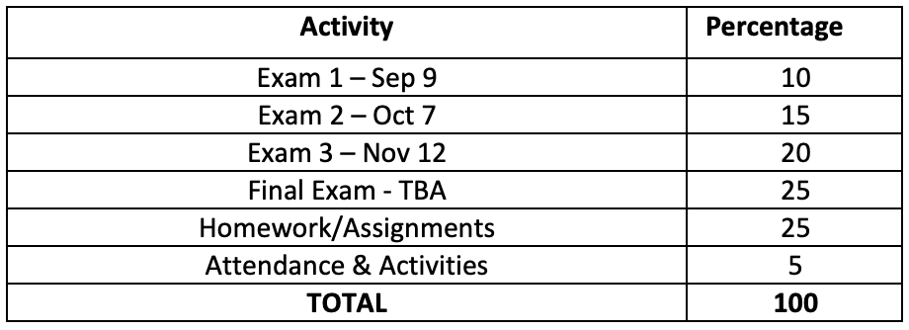
Introduction, Course Syllabus, and Coding Software
Notes:
Please state the grading scale is set and will not change. The grades will NOT be curved, and you must follow the common core grading scheme.

Slide 12

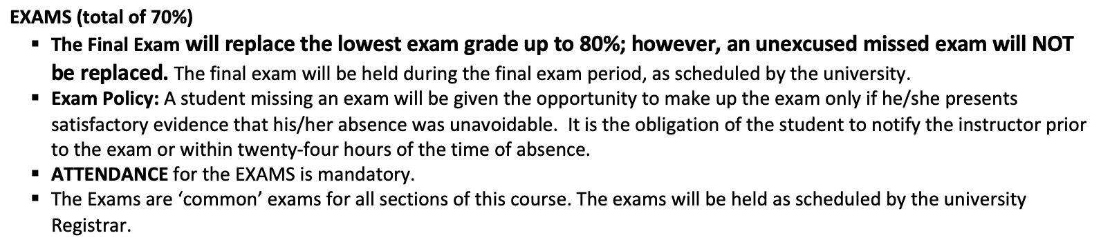

Introduction, Course Syllabus, and Coding Software

Slide 13
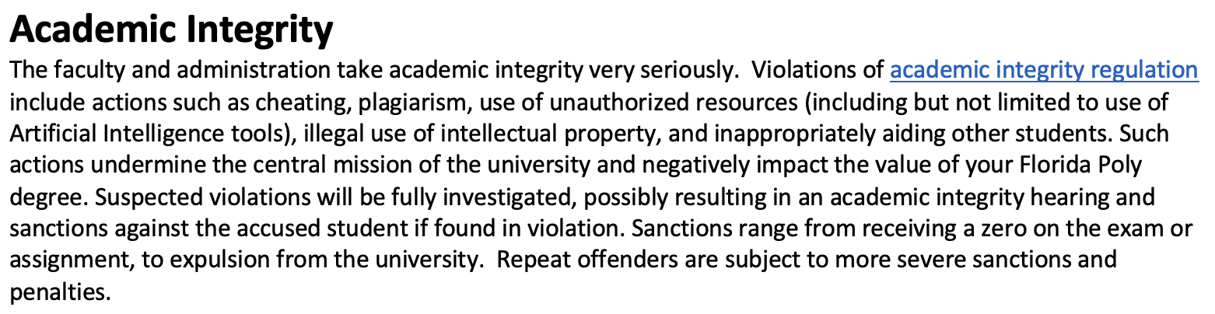

Introduction, Course Syllabus, and Coding Software
More on Academic Integrity:
Please try your best to NOT look or find solutions online.
Do not ask any chatbots for answers – most of the time they won’t get it exactly right!
Ask me for help, not chatbots or google!
Notes:
Please emphasize the importance of academic integrity and how it will NOT be tolerated.

Slide 14
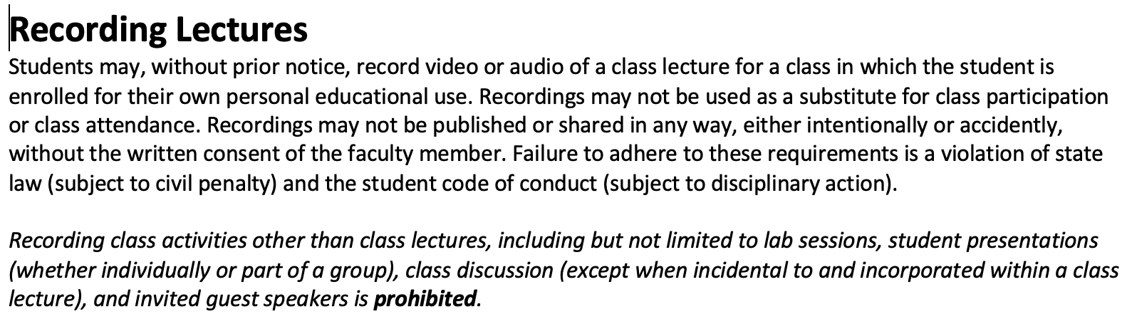

Introduction, Course Syllabus, and Coding Software
Please make sure to read the rest of the syllabus regarding: Accommodations, Title IX, and other university policies

Slide 15
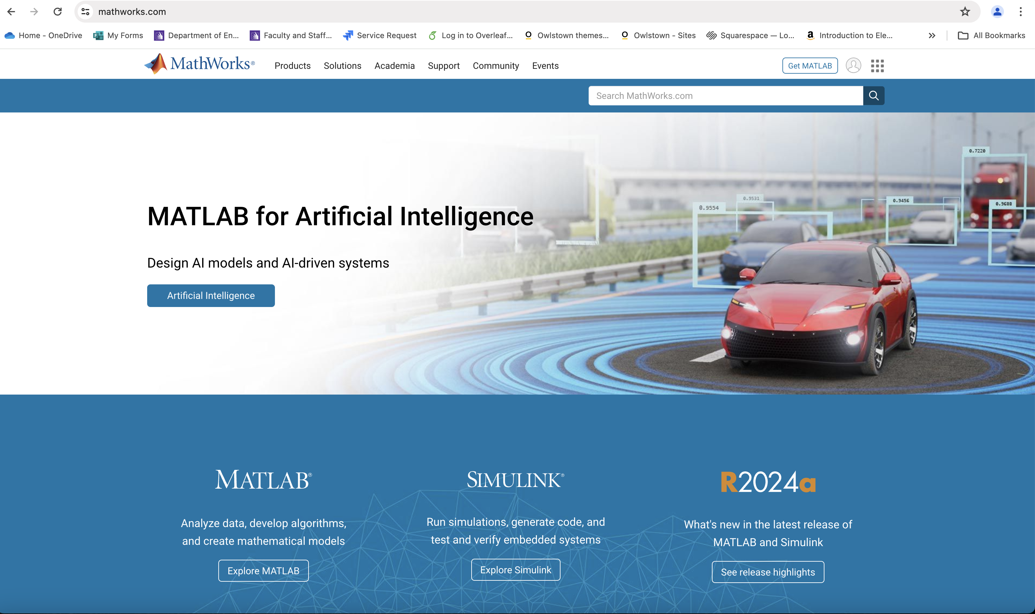

Introduction, Course Syllabus, and Coding Software
In this course, we will be using MATLAB for our coding needs.
MATLAB: MATrix LABoratory
It is a proprietary multi-paradigm programming language and numeric computing environment.
Developed by in the late 1970’s by Cleve Moler (Computer Programmer/Mathematician)
Mid 80’s, he cofounded MathWorks to commercialized MATLAB .
MATLAB is widely used in the industry and academia world-wide
MATLAB is used in a variety of STEM sectors (Aerospace/Defense, Biological, Chemical, Environmental/Climate, Financial, Automotive, Software engineering and others).
It is used by academics (professors, students, researchers, etc.) and by various others in government labs.
Notes:
Feel free to add your own personal experiences using MATLAB.

Slide 16
Introduction, Course Syllabus, and Coding Software
As a Florida Poly student, you have full access to MATLAB and its features.
We will be using an online version of MATLAB
The on-line version can do everything we need to be successful and meet our course objectives.
You may of course download, install, and use the desktop version if you would like.
However, please note, that we will be using the online version in class.
Thus, using the on-line version will ensure consistency for every student.
Let’s get started by creating an account and logging in

Slide 17

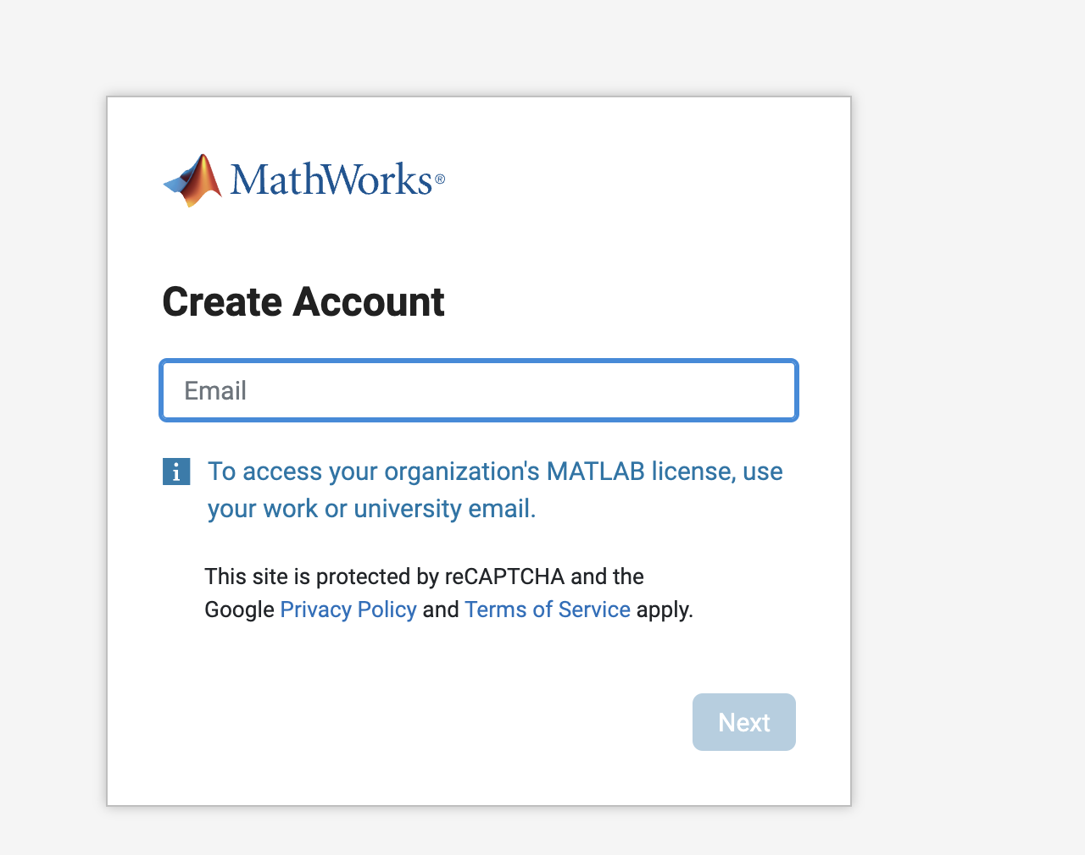
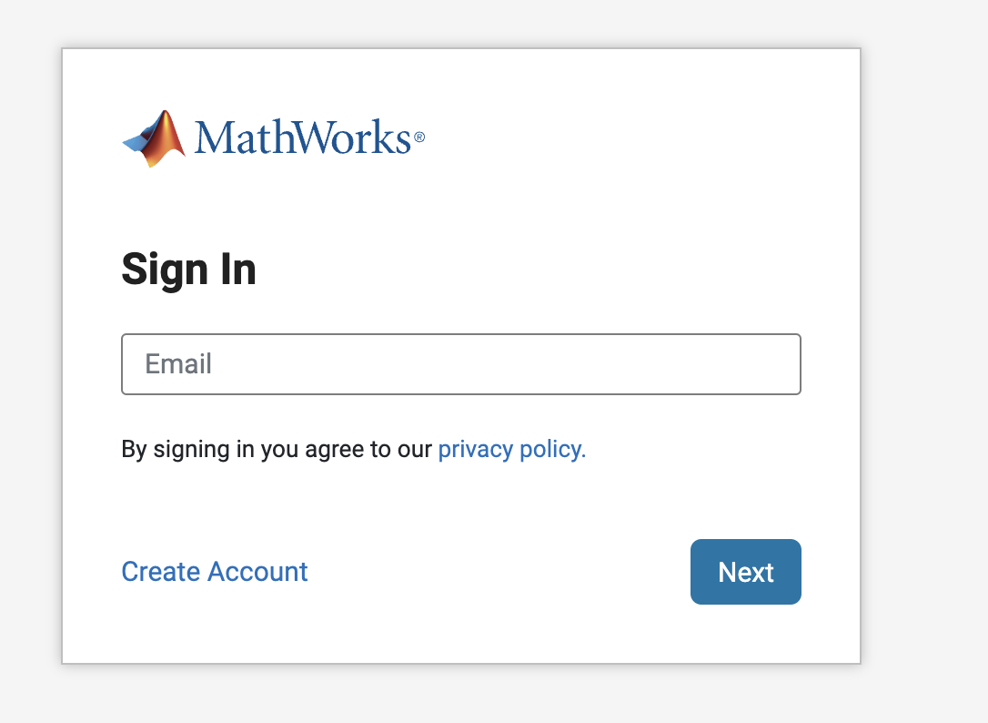
Introduction, Course Syllabus, and Coding Software
Create an account
Visit www.mathworks.com
Click the sign-in button on the top right
Use your Florida Poly email
Use your Florida Poly email
Create a good strong password
Click “Create Account”
Notes:
Please ensure all students can successfully create an account and log in accordingly.

Slide 18
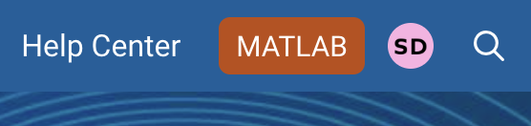
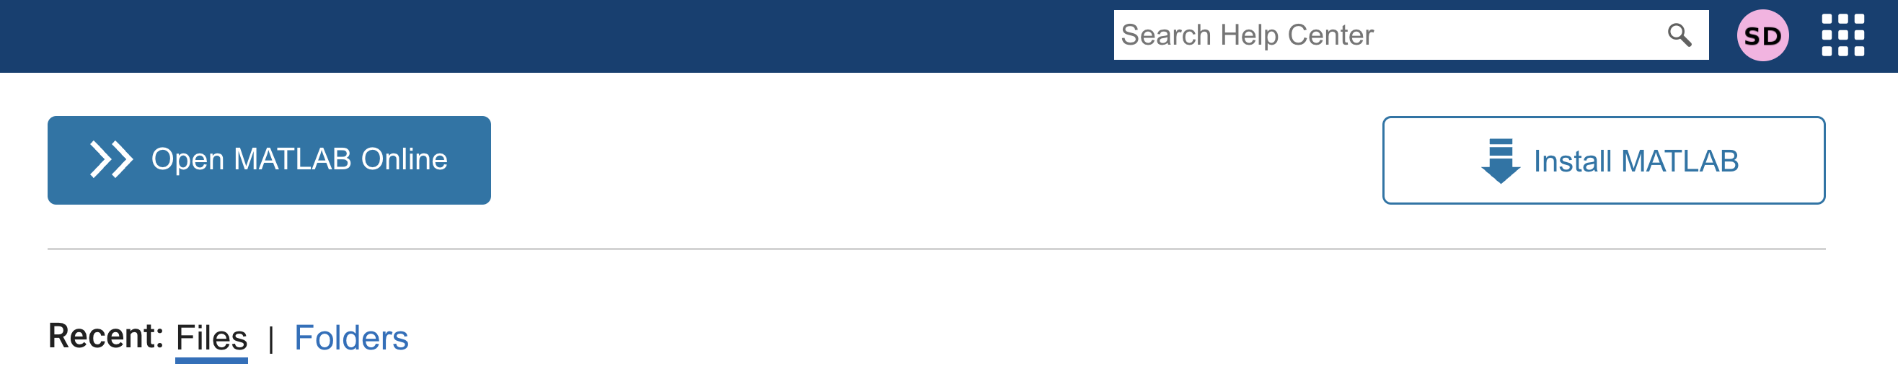
Introduction, Course Syllabus, and Coding Software
Once you are logged in, you should see your initials on the top right
Click on the MATLAB button next to your initials.
You will go to the following page
You can open your online version of Matlab from this page.
The square button with dots on the right of your initials gives you access to other mathwork products.

Slide 19
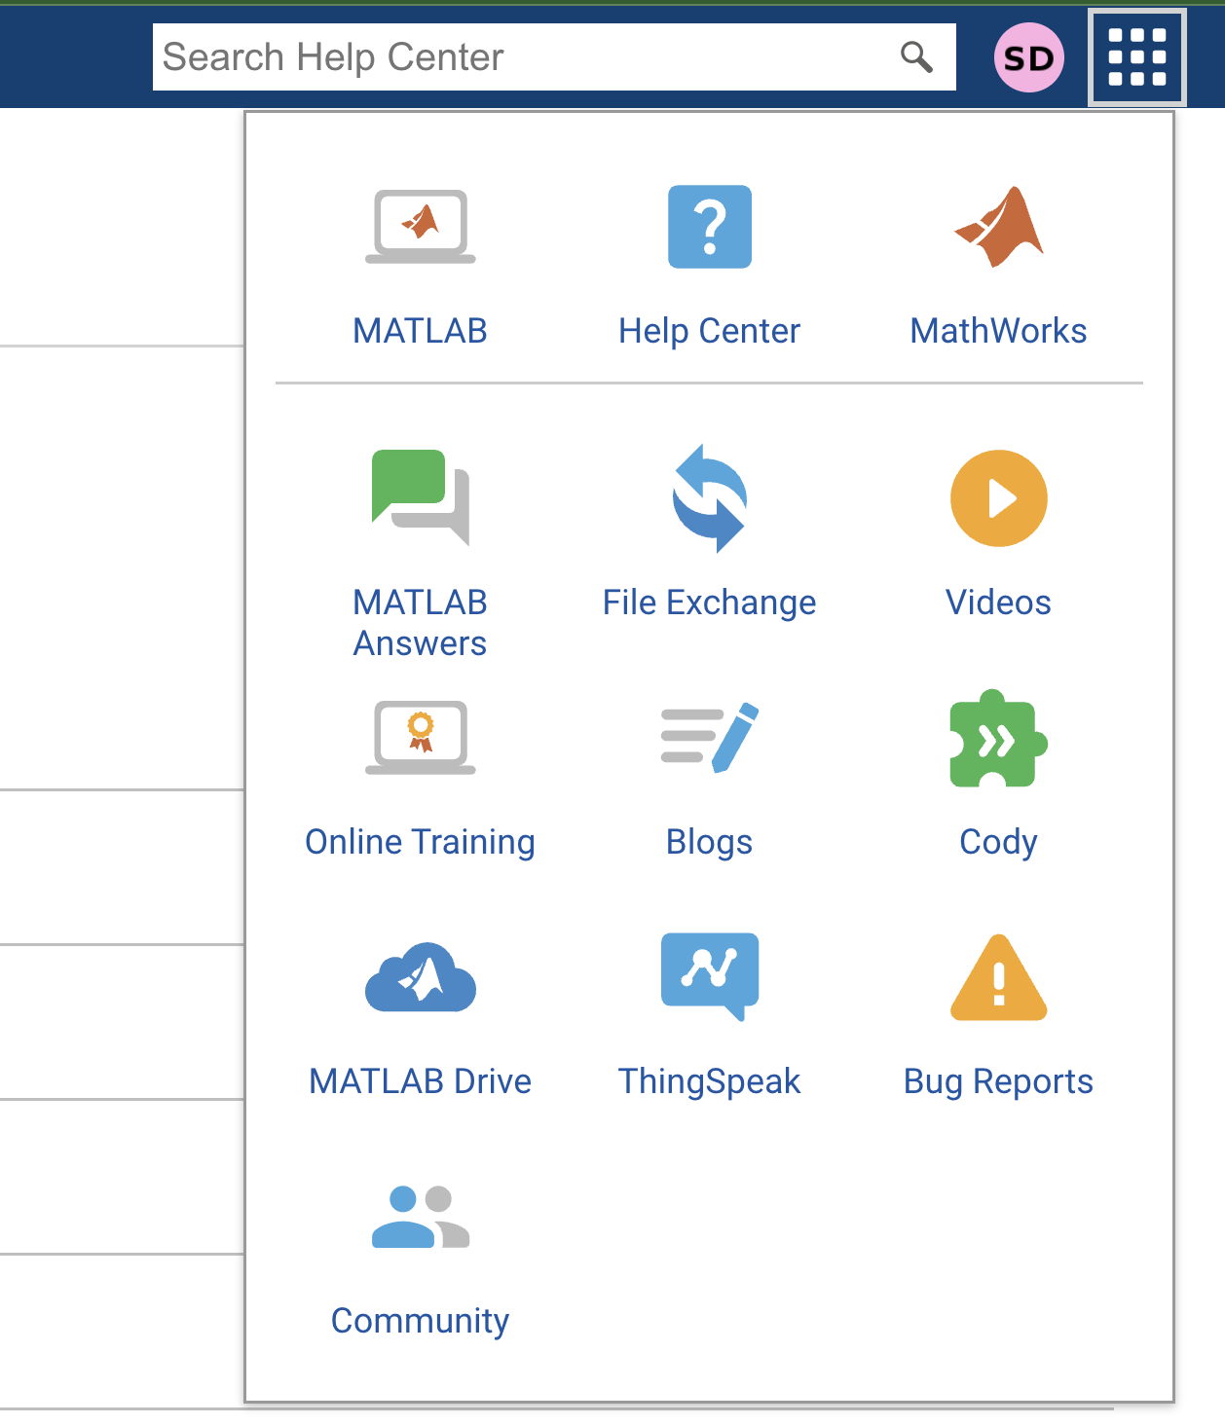
You will see this menu when you click on the dots.
MATLAB Drive is where all our files are going to be stored.
We will be able to access these files from MATLAB

Slide 20
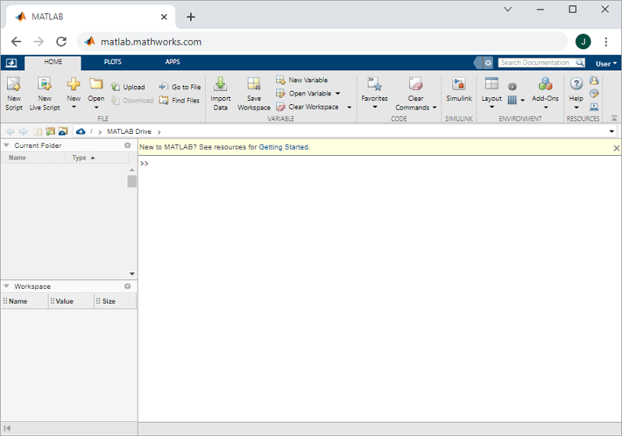
We will talk about MATLAB Drive later.
Let us click on Open MATLAB Online button.
This will open MATLAB in a new tab in your browser.
First time users should see a page as shown on the right.

Slide 21
This white space is called the command line
We will start by writing and executing commands here
It is marked by >>
Let’s get started with Chapter 1

Slide 22
Chapter 01: Overview
Learn the concepts for:
Program, formula, algorithm, variables, assignments, arithmetic expressions, input, output, strings, errors, conditionals, Boolean expressions, logical reasoning, pseudocode, flowchart.
Learn language features:
Script: code, program
Input functions (input), output functions (disp, fprintf)
Math expressions: sin, cos, pi
Boolean expressions: true or false
Conditionals: if else

Slide 23
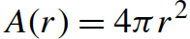
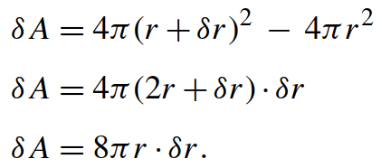
Let’s start with a problem!!! Problem 1: Description and Math
How much does the area of a sphere change by a small change in the radius?
Why: Video game, physics, engineering, optimization problem, etc
The surface area of a sphere depends on the radius, it is a function of the radius given by:
The change in area is: A _{final} –A _{initial} or
We have 3 formulas, two exact and one approximated

Slide 24
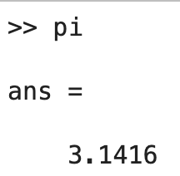
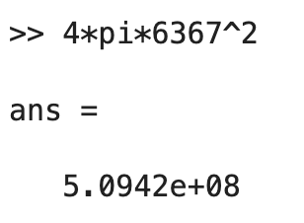
Use MATLAB command line as a calculator
Let's start by calculating the surface area of a sphere.
Radius of the Earth is r = 6367 km
Use the command line to calculate the surface area
Let’s type the following commands and hit return/enter!
What do the characters * and ^ mean?

Slide 25
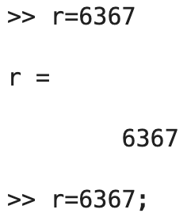
Assigning values in variables
The instruction “r = 6367” looks like an equation, it points to an operation. Technically “the value of 6367 has been assigned to r,” or you can think “r gets 6367,” If keyboards had arrows it would be more like this r ← 6367.
You can see the difference in adding a semicolon to the command (to skip printing the result of the command).

Slide 26
Rules for Variable Names:
Variables must start with a letter.
Variables can contain letters, numbers, and underscores only -- so no other special characters (! @ # $ % ^ & * -- ALL NOT ALLOWED).
Spaces are also NOT allowed.
Length of variables can go from 1 – 63 characters.
Valid | Not Valid
x | 1x
yz453 | $d4
Vel_1 | accel 3432
FoRce_2 | Three ^_@
ReallyLongName_12_22 | custom var name

Slide 27
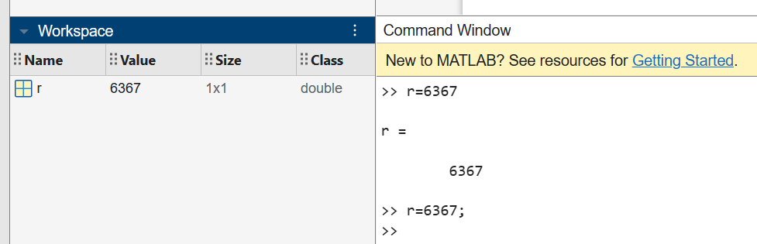
The Workspace
The Workspace lists the variables (with the size and class).
Once the variable is initialized, it can be used later

Slide 28
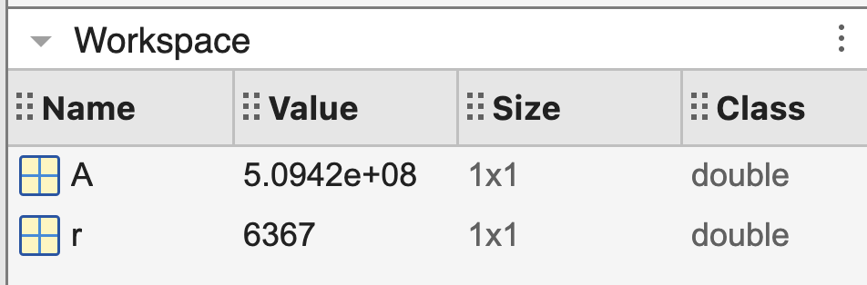
Calculate the surface area
Type the following commands:
>> r = 6367;
>> A = 4*pi*r^2;
What do you see in the workspace?
What if we want to calculate the surface are of a basketball?
Can we use the same technique?
Can we repeat the process for different values provided by a user?
For that we need to write a program/code!!

Slide 29
Objective of our first program
Obtain the radius from the user
Calculate the surface area
Display your results
Problem statement: Write a MATLAB code to input the radius of a sphere from the user and output the surface area.

Slide 30

What is a computer program?
A computer program is a sequence or set of instructions in a programming language for a computer to execute. (Wikipedia)
It helps us automate a task using computers.
We will write all our codes as MATLAB live scripts (or .mlx) files. Live Scripts are interactive documents that combine text, code, and output to ease documentation. Added in 2016.
Codes can also be written as general MATLAB scripts (.m) files.
The command to create a new live script is ‘edit’
Try this on your command line:

Slide 31
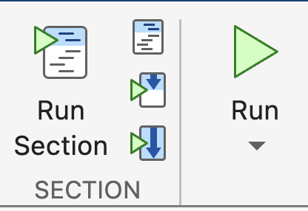
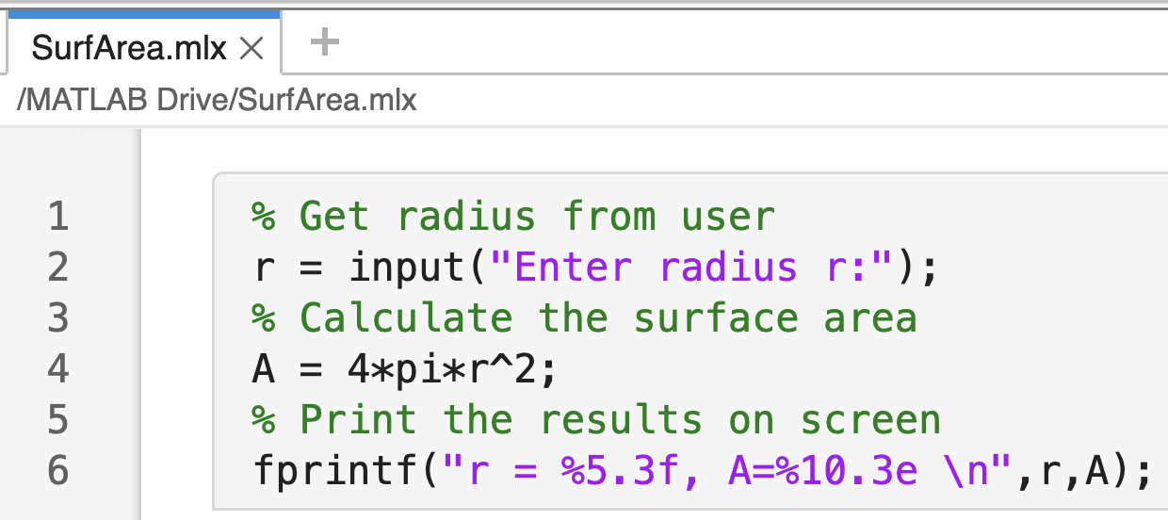
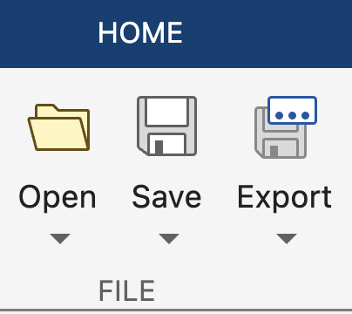
Coding a Script
Click on the Run or Run Section button
Editor Window shows the live script that we are editing.
Type in the following program
Remember to click on the Save button to save your live script.
Notes:
You can polish the code as much as you want, the next slide will explain the details.
The live script is the newest was Released in 2016 and add interactive documents that combine text, code, and output.

Slide 32
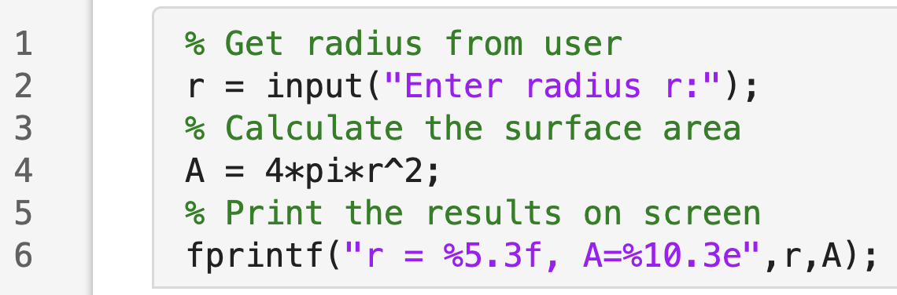
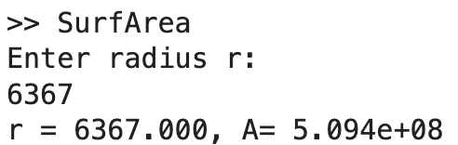
Code explained
Comments begin with the percent % symbol and helps us remember our steps
The input statement is an effective way to prompt the user for data. A sequence of characters delimited by single quotes is called a string (text)
The script can be run from command line
fprintf command displays formatted output
Output in command line

Slide 33
The fprintf function
The fprintf command also includes a string (text). The string is a message with special character to the display format for result:
format for r (up to 5 digits and 3 decimal places)
f = float (decimal floating point)
format for A (up to 10 digits and 3 decimal places)
e = exponent for scientific notation
\n carriage return for new line
Output string with text formatting
Variables from the formatting
Output string
Documentation for fprintf command can be found at https://www.mathworks.com/help/matlab/ref/fprintf.html?searchHighlight=fprintf&s_tid=srchtitle_support_results_1_fprintf

